Slide 1
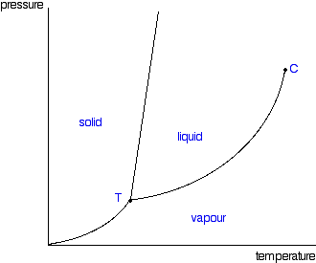
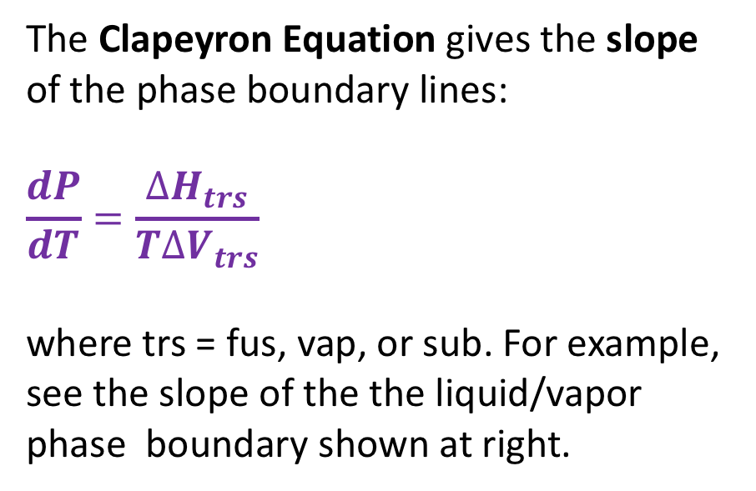

Recap: Clapeyron equation
The Clapeyron Equation gives the slope of the phase boundary lines:
$$\frac{dP}{dT}=\frac{∆H_{trs}}{T∆V_{trs}}$$
where trs = fus, vap, or sub. For example, see the slope of the the liquid/vapor phase boundary shown at right.
$$∆H_{vap}$$
$$∆V_{vap}$$

Slide 2
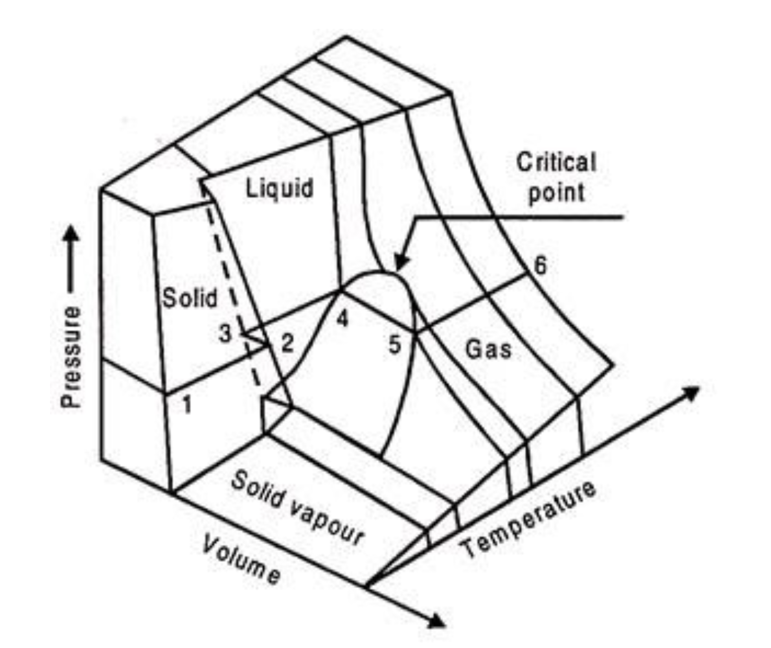
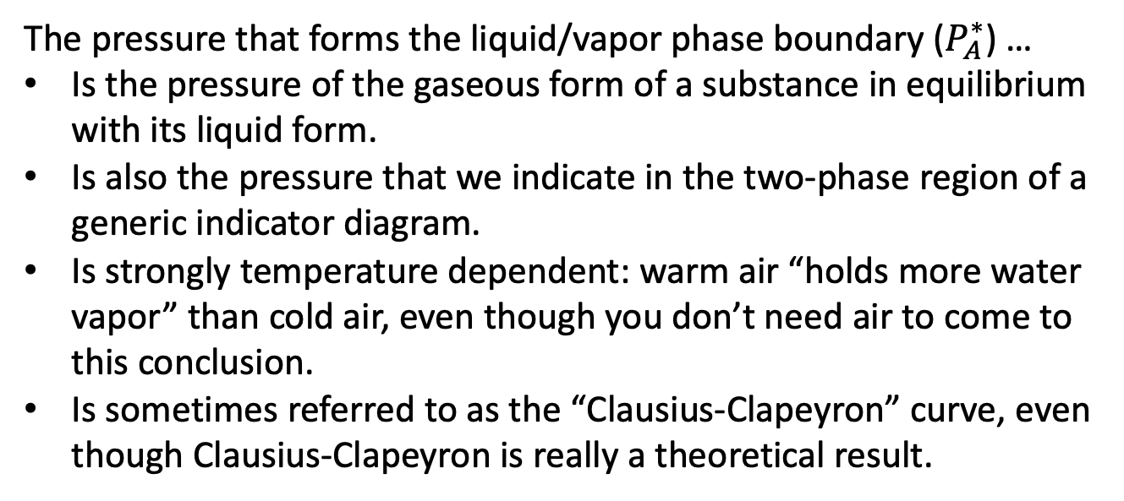


Multiple ways of thinking about the liquid-vapor phase boundary
The pressure that forms the liquid/vapor phase boundary ($P_{A}^{∗}$) …
Is the pressure of the gaseous form of a substance in equilibrium with its liquid form.
Is also the pressure that we indicate in the two-phase region of a generic indicator diagram.
Is strongly temperature dependent: warm air “holds more water vapor” than cold air, even though you don’t need air to come to this conclusion.
Is sometimes referred to as the “Clausius-Clapeyron” curve, even though Clausius-Clapeyron is really a theoretical result.
A(g)
$P_{A}^{∗}$
A
A
A
A
A
A
Pure A(l)
A
A
Generic indicator diagram
P
$$P_{A}^{∗}(T)$$
T

Slide 3
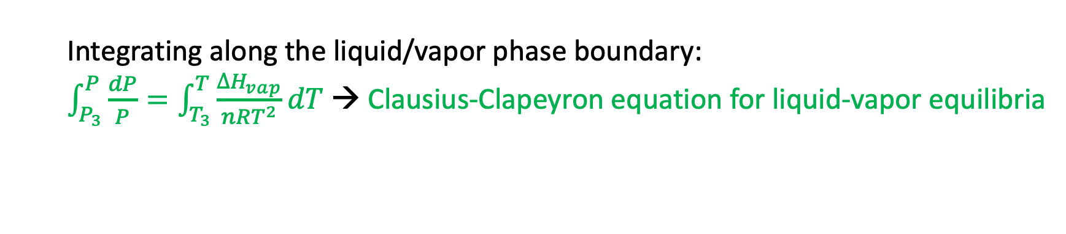
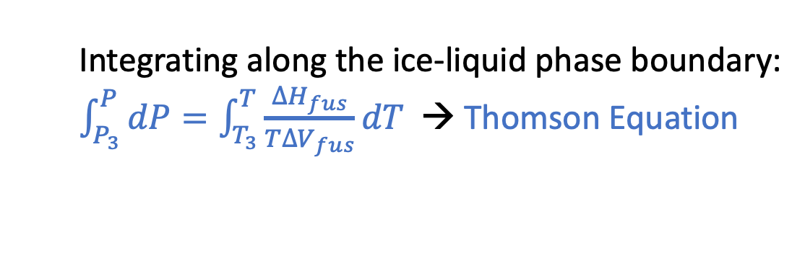
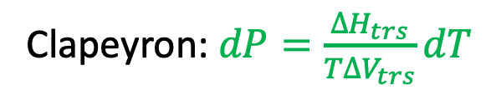
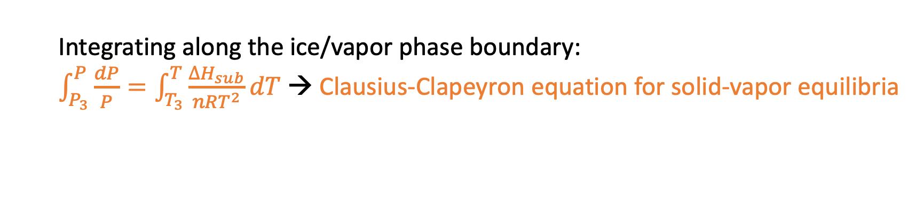
Integrating the Clapeyron Equation
Clapeyron: $dP=\frac{∆H_{trs}}{T∆V_{trs}}dT$
P
Integrating along the ice-liquid phase boundary:
$\int_{P_{3}}^{P}{dP}=\int_{T_{3}}^{T}{\frac{∆H_{fus}}{T∆V_{fus}}dT}$ → Thomson Equation
Integrating along the liquid/vapor phase boundary:
$\int_{P_{3}}^{P}{\frac{dP}{P}}=\int_{T_{3}}^{T}{\frac{∆H_{vap}}{nRT^{2}}dT}$ → Clausius-Clapeyron equation for liquid-vapor equilibria
T
Integrating along the ice/vapor phase boundary:
$\int_{P_{3}}^{P}{\frac{dP}{P}}=\int_{T_{3}}^{T}{\frac{∆H_{sub}}{nRT^{2}}dT}$ → Clausius-Clapeyron equation for solid-vapor equilibria

Slide 4
What we’ve learned …
Multiple ways of thinking about the liquid-vapor phase boundary.
How to integrate Clapeyron to get Thomson and Clausius-Clapeyron.
How phase diagrams are related to these equations.

Slide 5
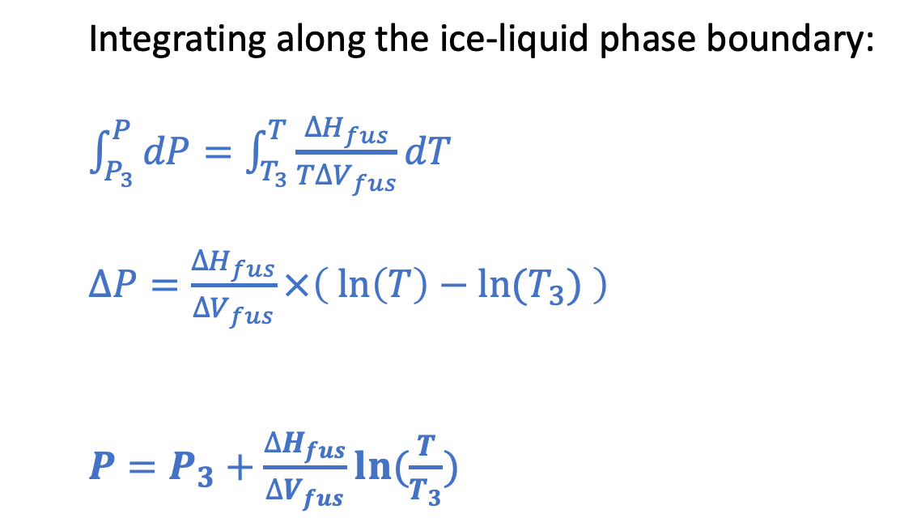
Thomson (for the ice-liquid phase boundary)
P
Integrating along the ice-liquid phase boundary:
$\int_{P_{3}}^{P}{dP}=\int_{T_{3}}^{T}{\frac{∆H_{fus}}{T∆V_{fus}}dT}$
$∆P=\frac{∆H_{fus}}{∆V_{fus}}×\left(\ln\left(T\right)−ln⁡(T_{3}) \right)$
$P=P_{3}+\frac{∆H_{fus}}{∆V_{fus}}ln⁡(\frac{T}{T_{3}})$
T

Slide 6
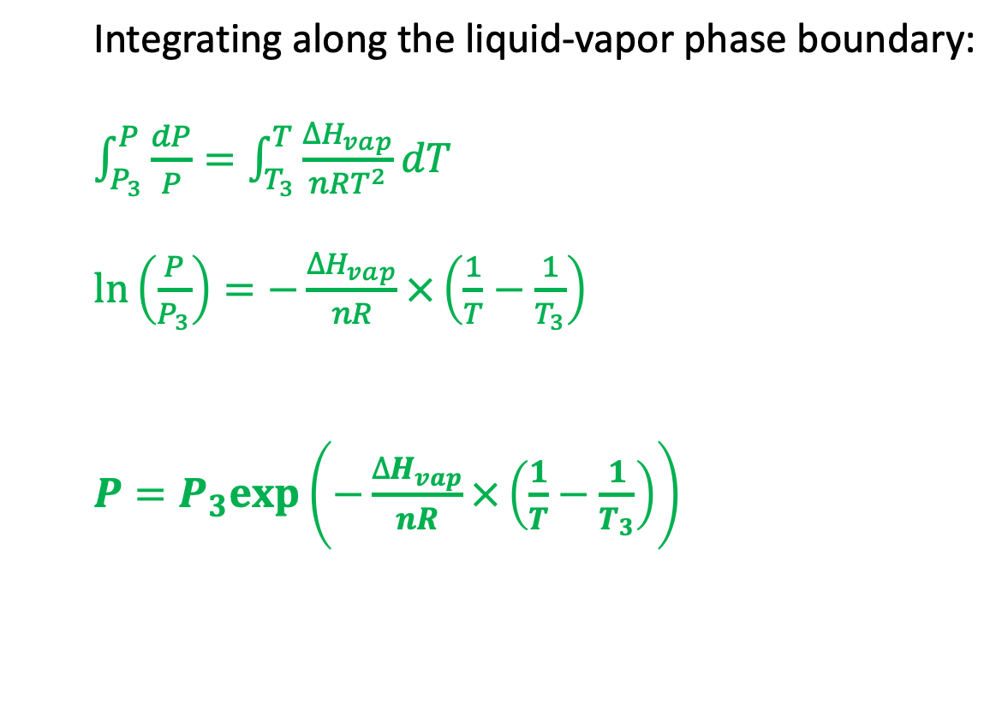
Clausius-Clapeyron (for the liquid-vapor phase boundary)
P
Integrating along the liquid-vapor phase boundary:
$\int_{P_{3}}^{P}{\frac{dP}{P}}=\int_{T_{3}}^{T}{\frac{∆H_{vap}}{nRT^{2}}dT}$
$\ln\left(\frac{P}{P_{3}}\right)=−\frac{∆H_{vap}}{nR}×\left(\frac{1}{T}−\frac{1}{T_{3}}\right)$
$P=P_{3}exp⁡\left(−\frac{∆H_{vap}}{nR}×\left(\frac{1}{T}−\frac{1}{T_{3}}\right)\right)$
T

Slide 7
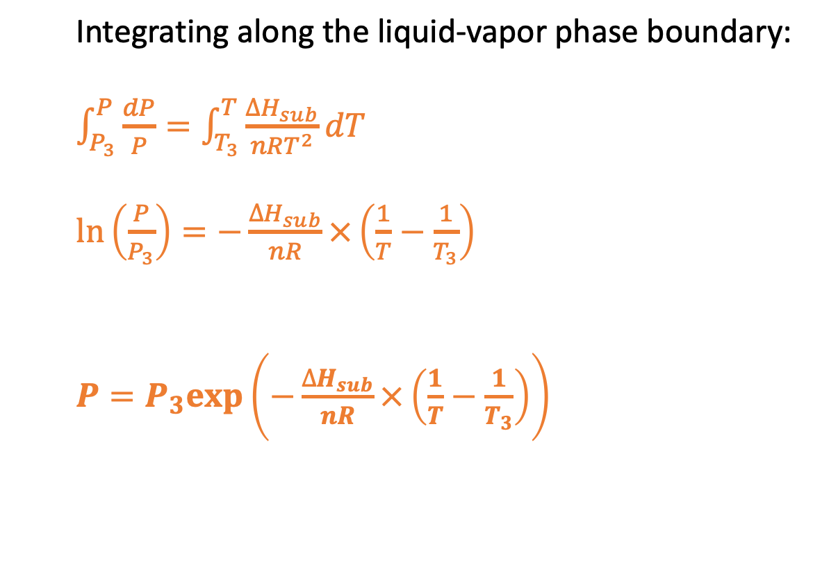
Clausius-Clapeyron (for the solid-vapor phase boundary)
P
Integrating along the liquid-vapor phase boundary:
$\int_{P_{3}}^{P}{\frac{dP}{P}}=\int_{T_{3}}^{T}{\frac{∆H_{sub}}{nRT^{2}}dT}$
$\ln\left(\frac{P}{P_{3}}\right)=−\frac{∆H_{sub}}{nR}×\left(\frac{1}{T}−\frac{1}{T_{3}}\right)$
$P=P_{3}exp⁡\left(−\frac{∆H_{sub}}{nR}×\left(\frac{1}{T}−\frac{1}{T_{3}}\right)\right)$
T

